Slide 1


Cardiac aging synthesis from cross-sectional data with cGAN
Sergi Bech
David Rosado

Slide 2
Outline
Introduction to the problem and data
Methodology presented
Overview of validation results
Strong points and limitations
Future lines

Slide 3
1.Introduction
How age affects our body, specially the age of our heart.
Age is related to changes in structures.
Longitudinal data.
Cross sectional data.
Paper approach.

Slide 4
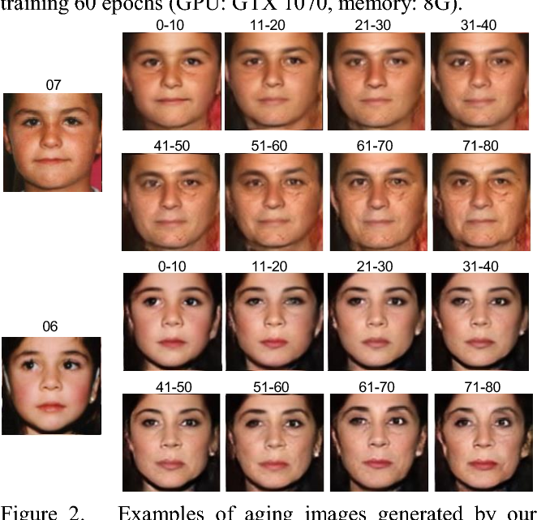
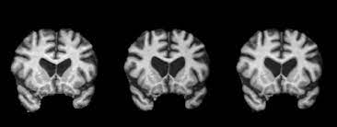
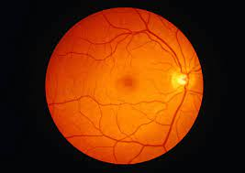
1.Related studies
Face aging (Liu et al.)
Brain aging (Xia et al.)
Future fundus (Ahn S. et al.)
StarGAN-v2 (Choi. et al.)

Slide 5
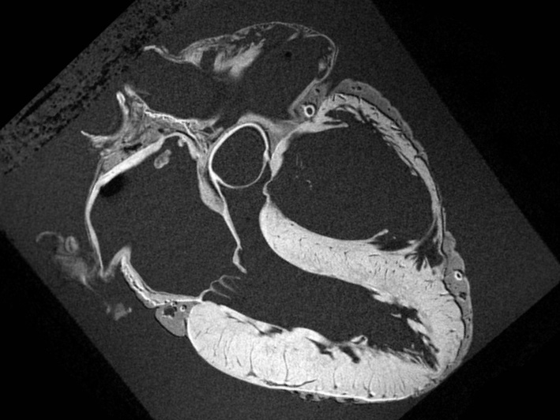
1.Dataset
MRI images from +14.000 subjects (UK Biobank).
Four chamber images from end-diastolic phase.
No pre-processing.

Slide 6
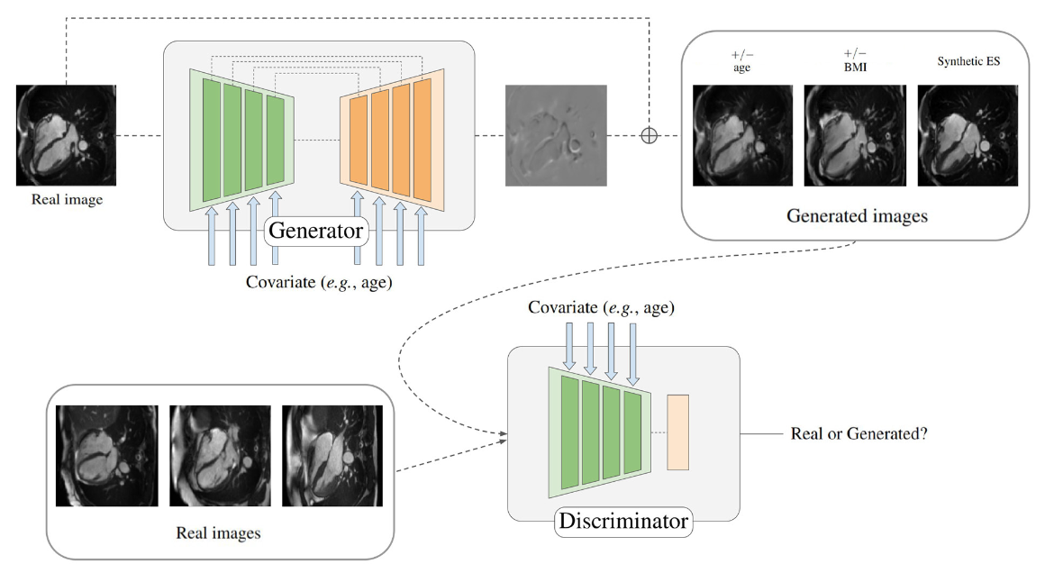
2.Methodology

Slide 7
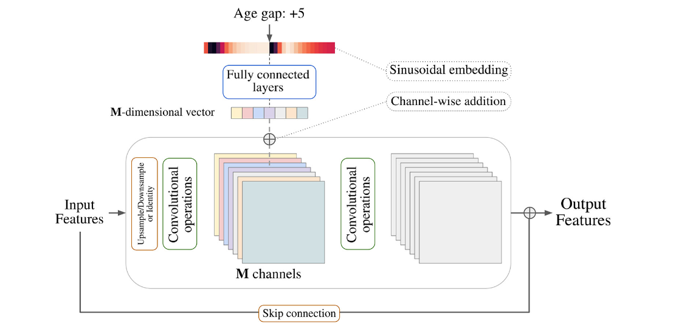
2.Methodology

Slide 8
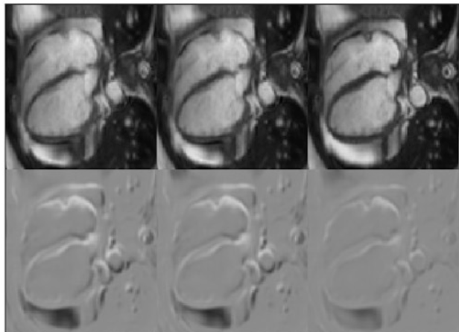


2.Training details
Wasserstein-GAN with loss penalty.
Cycle-consistency loss term.
Data Augmentation.

Slide 9
3.Validation Results
Two main approaches for validate the results:
Age accuracy and image quality.
Train age regressors with an imbalance dataset augmented with synthetic images.

Slide 10
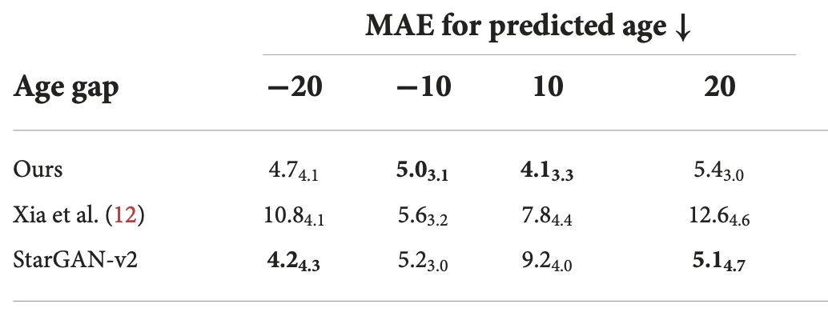
Assessment via predicted age
Use of a pre-trained ResNet18 age regressor and use MAE between predicted age and target age.

Slide 11
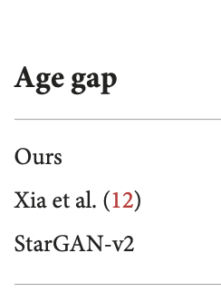
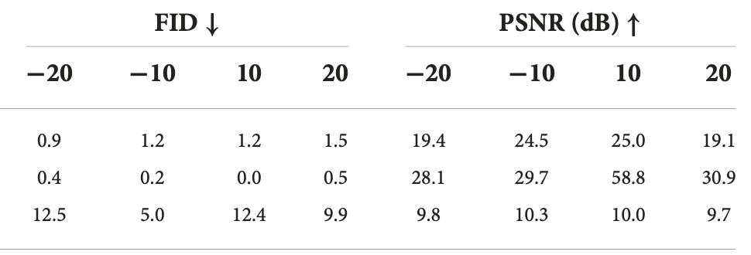
Assessment via image quality
Use of FID and PSNR.

Slide 12
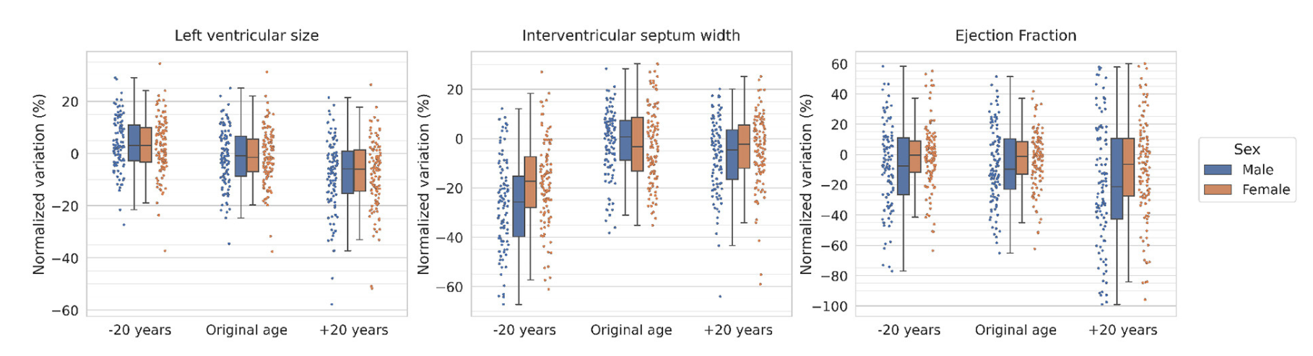
Volumetric analysis
Automatic segmentations of the original and synthesized images of LV size, interventricular septum width and the ejection fraction.

Slide 13
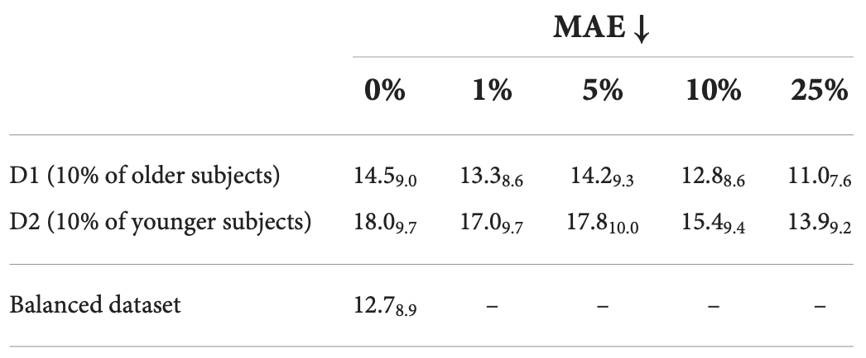
Synthetic images as data augmentation
Use of a ResNet18 age regressor with two datasets of 1000 subjects:
D1: 90% of the subjects younger than 70 years old.
D2: 90% of the subjects older than 60 years old.

Slide 14
4. Strong points and limitations
Strong points:
First approach that allows a cGAN modify a cardiac image in two directions, increased and decreased age.
Realistic modifications without the need of complicated pre-process, comparable to the state-of-the-art.
The volumetric analysis is consistent with the literature.
Counter-balancing biased datasets.

Slide 15
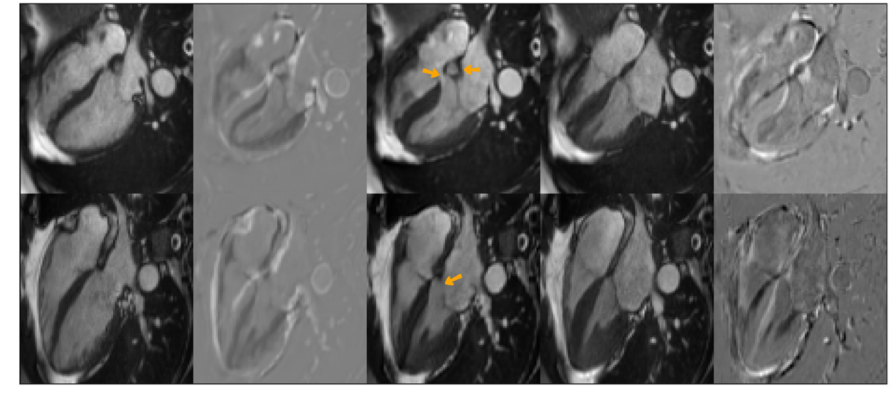
4. Strong points and limitations
Limitations:
The model has not been validated against real longitudinal data.
The model is observed to produce images with clinical inaccuracies.

Slide 16
5. Future lines
Improving the quality of synthetic data.
Extending the approach to other populations.
Incorporating longitudinal data.
Try others architectures (diffusion models).

Slide 17
Data Science for Health

